Slide 1
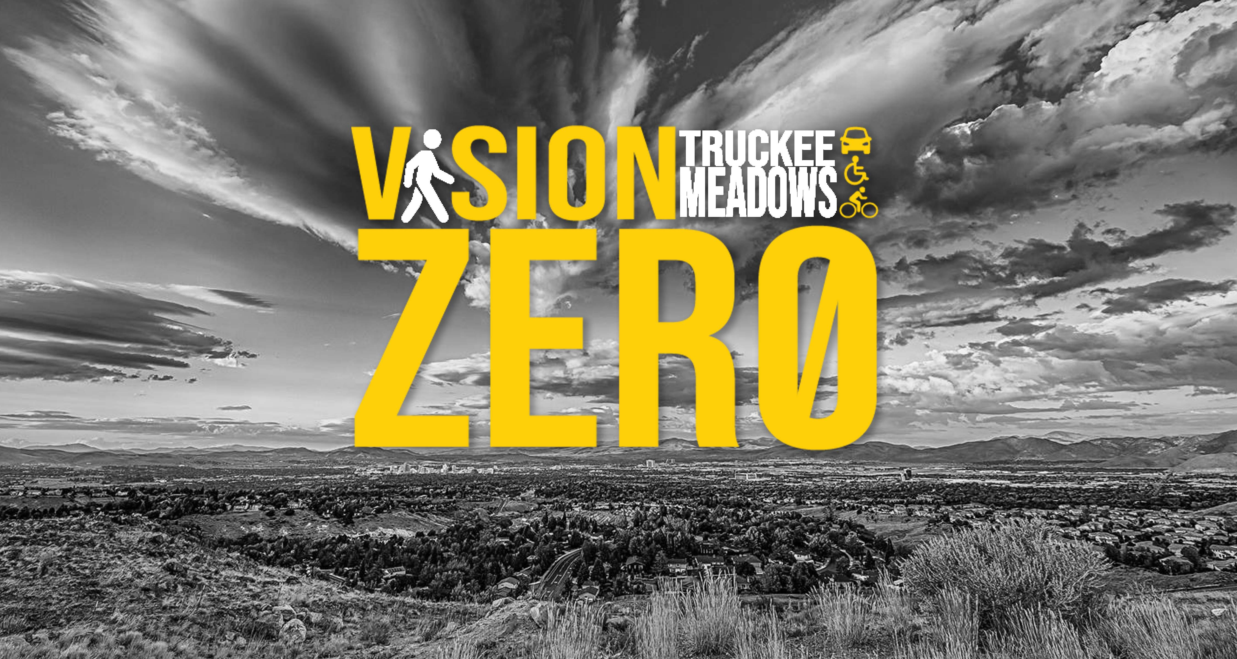

Slide 2
t
VISION ZERO TRUCKEE MEADOWS
Notes:
Task force is growing, recently Renown, Nevada Highway Patrol and Washoe County Sheriff joined our regional efforts

Slide 3
Zero Pedestrian Fatalities by 2030
Action Plan:
Three components:
Programmatic
Street Design/Infrastructure
Community Engagement/Outreach
Measurable Outcomes
Used equitable, data-driven, transparent decisions and actions to improve safety throughout our community
Notes:
Discuss that we used the data from the 4 focus areas, pedestrian surveys, crash data between 2011-2017 to compile the action plan. In June, the task force voted to adopt the action plan and now we’re bringing it to the RTC Board for their acceptance and Resolution.

Slide 4
Action Plan Goals
Programmatic - Adopt the goal of reaching zero fatalities by 2030
Street Design/Infrastructure – Develop a regional lighting standard and enhance street lighting to improve visibility throughout the Truckee Meadows
Community Engagement/Outreach – Recommend, pursue and establish Pedestrian Safety Zones
Notes:
Here are 3 examples from the action plan, one from each section

Slide 5
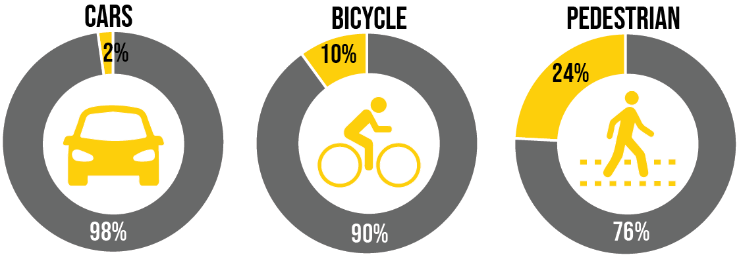
^{What’s the Goal at Your House?}
2013 – 2017 Crash Data
Share of victims who were killed or seriously injured
Notes:
When people say 2030 is not realistic for zero pedestrian fatalities, we ask what is the goal in your house? These infographics show us that the most vulnerable user, the pedestrian and bicyclist, have a greater chance of a serious injury or fatality. Between 2013 – 2017, of the pedestrian crashes, 24% of the pedestrians involved in crashes were seriously injured or killed. Between these same 5 years, 10% of bicyclists involved in a crash were either killed or seriously injured. And people in cars were the least likely to be seriously injured or killed in a crash at 2% of the crashes involving cars were victims. We know that when we make the road safer for a pedestrian, the most vulnerable road user, we make the road safe for all road users.

Slide 6
^{What’s Next?}
Acceptance of the Action Plan, and to support submittal of application to become a National Vision Zero Community

Slide 7
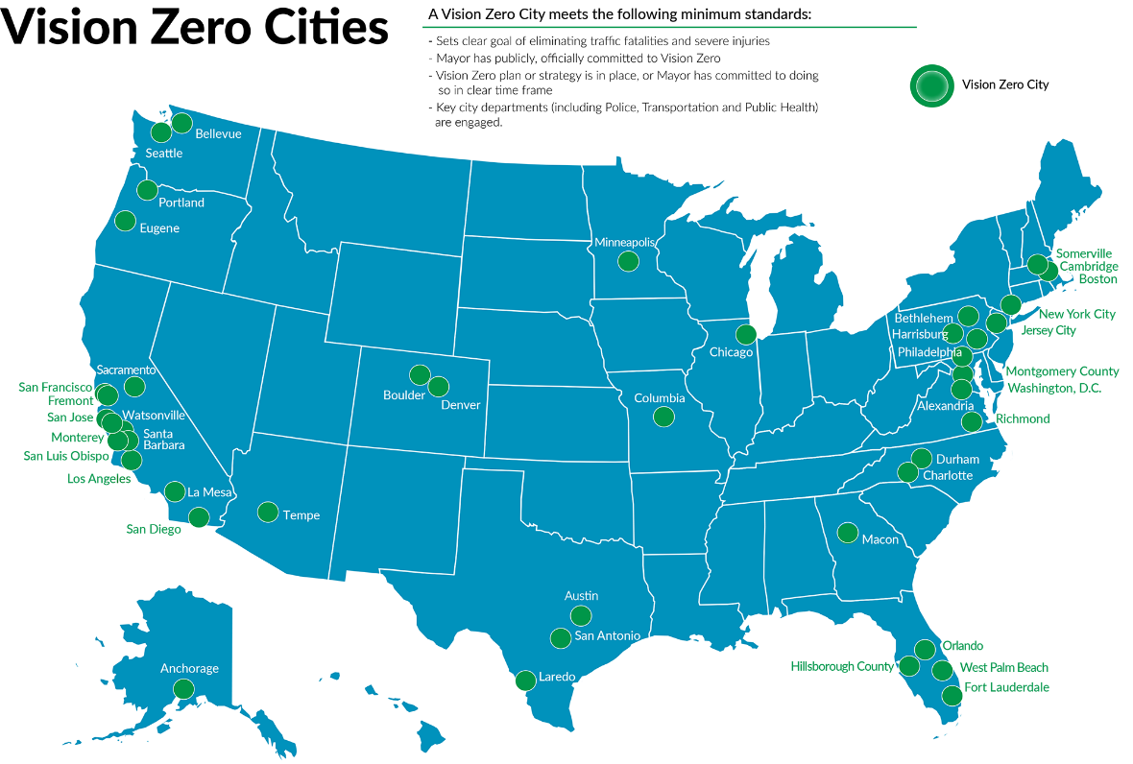
^{Vision Zero in} ^{Nevada}

Slide 8
^{Questions}
Rebecca Kapuler
RTC Planner
rkapuler@rtcwashoe.com

